Slide 1
1.1 Number systems
Converting between number systems – Part 2

Slide 2
About hexadecimal
Denary | Binary | Hexadecimal
0
1
2
3
4
5
6
7
8
9
10
11
12
13
14
15

Slide 3
About hexadecimal
Denary | Binary | Hexadecimal
0 | 0000
1 | 0001
2 | 0010
3 | 0011
4 | 0100
5 | 0101
6 | 0110
7 | 0111
8 | 1000
9 | 1001
10 | 1010
11 | 1011
12 | 1100
13 | 1101
14 | 1110
15 | 1111

Slide 4
About hexadecimal
Denary | Binary | Hexadecimal
0 | 0000
1 | 0001
2 | 0010
3 | 0011
4 | 0100
5 | 0101
6 | 0110
7 | 0111
8 | 1000
9 | 1001
10 | 1010
11 | 1011
12 | 1100
13 | 1101
14 | 1110
15 | 1111

Slide 5
About hexadecimal
Denary | Binary | Hexadecimal
0 | 0000 | 0
1 | 0001 | 1
2 | 0010 | 2
3 | 0011 | 3
4 | 0100 | 4
5 | 0101 | 5
6 | 0110 | 6
7 | 0111 | 7
8 | 1000 | 8
9 | 1001 | 9
10 | 1010
11 | 1011
12 | 1100
13 | 1101
14 | 1110
15 | 1111

Slide 6
About hexadecimal
Denary | Binary | Hexadecimal
0 | 0000 | 0
1 | 0001 | 1
2 | 0010 | 2
3 | 0011 | 3
4 | 0100 | 4
5 | 0101 | 5
6 | 0110 | 6
7 | 0111 | 7
8 | 1000 | 8
9 | 1001 | 9
10 | 1010 | A
11 | 1011 | B
12 | 1100 | C
13 | 1101 | D
14 | 1110 | E
15 | 1111 | F

Slide 7
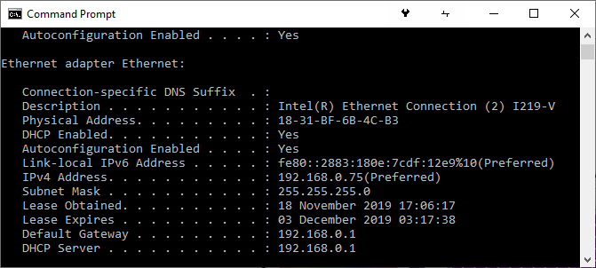
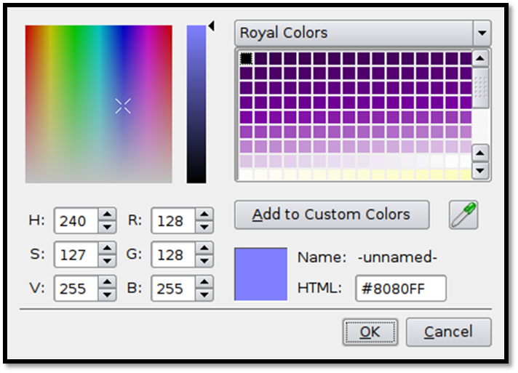
About hexadecimal
Denary | Binary | Hexadecimal
0 | 0000 | 0
1 | 0001 | 1
2 | 0010 | 2
3 | 0011 | 3
4 | 0100 | 4
5 | 0101 | 5
6 | 0110 | 6
7 | 0111 | 7
8 | 1000 | 8
9 | 1001 | 9
10 | 1010 | A
11 | 1011 | B
12 | 1100 | C
13 | 1101 | D
14 | 1110 | E
15 | 1111 | F

Slide 8
About hexadecimal
Denary | Binary | Hexadecimal
0 | 0000 | 0
1 | 0001 | 1
2 | 0010 | 2
3 | 0011 | 3
4 | 0100 | 4
5 | 0101 | 5
6 | 0110 | 6
7 | 0111 | 7
8 | 1000 | 8
9 | 1001 | 9
10 | 1010 | A
11 | 1011 | B
12 | 1100 | C
13 | 1101 | D
14 | 1110 | E
15 | 1111 | F

Slide 9
About hexadecimal
Denary | Binary | Hexadecimal
0 | 0000 | 0
1 | 0001 | 1
2 | 0010 | 2
3 | 0011 | 3
4 | 0100 | 4
5 | 0101 | 5
6 | 0110 | 6
7 | 0111 | 7
8 | 1000 | 8
9 | 1001 | 9
10 | 1010 | A
11 | 1011 | B
12 | 1100 | C
13 | 1101 | D
14 | 1110 | E
15 | 1111 | F

Slide 10
Converting between denary and 2-digit hexadecimal
Denary | 12
Binary | 128 | 64 | 32 | 16 | 8 | 4 | 2 | 1
Nibble | 8 | 4 | 2 | 1 | 8 | 4 | 2 | 1
Hexadecimal

Slide 11
Converting between denary and 2-digit hexadecimal
MSB
LSB
Denary | 12
Binary | 128 | 64 | 32 | 16 | 8 | 4 | 2 | 1
Nibble | 8 | 4 | 2 | 1 | 8 | 4 | 2 | 1
Hexadecimal
Most Significant Bit
Least Significant Bit

Slide 12
Converting between denary and 2-digit hexadecimal
Denary | 12
Binary | 128 | 64 | 32 | 16 | 8 | 4 | 2 | 1
 | 0 | 0 | 0 | 0 | 1 | 1 | 0 | 0
Nibble | 8 | 4 | 2 | 1 | 8 | 4 | 2 | 1
Hexadecimal

Slide 13
Converting between denary and 2-digit hexadecimal
Denary | 12
Binary | 128 | 64 | 32 | 16 | 8 | 4 | 2 | 1
 | 0 | 0 | 0 | 0 | 1 | 1 | 0 | 0
Nibble | 8 | 4 | 2 | 1 | 8 | 4 | 2 | 1
Hexadecimal | 0

Slide 14

Converting between denary and 2-digit hexadecimal
Denary | 12
Binary | 128 | 64 | 32 | 16 | 8 | 4 | 2 | 1
 | 0 | 0 | 0 | 0 | 1 | 1 | 0 | 0
Nibble | 8 | 4 | 2 | 1 | 8 | 4 | 2 | 1
Hexadecimal | 0 |  |  |  | C

Slide 15
Converting between denary and 2-digit hexadecimal
Denary | 24
Binary | 128 | 64 | 32 | 16 | 8 | 4 | 2 | 1
Nibble | 8 | 4 | 2 | 1 | 8 | 4 | 2 | 1
Hexadecimal

Slide 16
Converting between denary and 2-digit hexadecimal
Denary | 24
Binary | 128 | 64 | 32 | 16 | 8 | 4 | 2 | 1
 | 0 | 0 | 0 | 1 | 1 | 0 | 0 | 0
Nibble | 8 | 4 | 2 | 1 | 8 | 4 | 2 | 1
Hexadecimal

Slide 17
Converting between denary and 2-digit hexadecimal
Denary | 24
Binary | 128 | 64 | 32 | 16 | 8 | 4 | 2 | 1
 | 0 | 0 | 0 | 1 | 1 | 0 | 0 | 0
Nibble | 8 | 4 | 2 | 1 | 8 | 4 | 2 | 1
Hexadecimal | 1

Slide 18
Converting between denary and 2-digit hexadecimal
Denary | 24
Binary | 128 | 64 | 32 | 16 | 8 | 4 | 2 | 1
 | 0 | 0 | 0 | 1 | 1 | 0 | 0 | 0
Nibble | 8 | 4 | 2 | 1 | 8 | 4 | 2 | 1
Hexadecimal | 1 |  |  |  | 8

Slide 19
Converting between denary and 2-digit hexadecimal
Denary | 230
Binary | 128 | 64 | 32 | 16 | 8 | 4 | 2 | 1
Nibble | 8 | 4 | 2 | 1 | 8 | 4 | 2 | 1
Hexadecimal

Slide 20
Converting between denary and 2-digit hexadecimal
Denary | 230
Binary | 128 | 64 | 32 | 16 | 8 | 4 | 2 | 1
 | 1 | 1 | 1 | 0 | 0 | 1 | 1 | 0
Nibble | 8 | 4 | 2 | 1 | 8 | 4 | 2 | 1
Hexadecimal

Slide 21
Converting between denary and 2-digit hexadecimal
Denary | 230
Binary | 128 | 64 | 32 | 16 | 8 | 4 | 2 | 1
 | 1 | 1 | 1 | 0 | 0 | 1 | 1 | 0
Nibble | 8 | 4 | 2 | 1 | 8 | 4 | 2 | 1
Hexadecimal | E

Slide 22
Converting between denary and 2-digit hexadecimal
Denary | 230
Binary | 128 | 64 | 32 | 16 | 8 | 4 | 2 | 1
 | 1 | 1 | 1 | 0 | 0 | 1 | 1 | 0
Nibble | 8 | 4 | 2 | 1 | 8 | 4 | 2 | 1
Hexadecimal | E |  |  |  | 6

Slide 23
Converting between denary and 2-digit hexadecimal
Denary | 100
Binary | 128 | 64 | 32 | 16 | 8 | 4 | 2 | 1
Nibble | 8 | 4 | 2 | 1 | 8 | 4 | 2 | 1
Hexadecimal

Slide 24
Converting between denary and 2-digit hexadecimal
Denary | 100
Binary | 128 | 64 | 32 | 16 | 8 | 4 | 2 | 1
 | 0 | 1 | 1 | 0 | 0 | 1 | 0 | 0
Nibble | 8 | 4 | 2 | 1 | 8 | 4 | 2 | 1
Hexadecimal

Slide 25
Converting between denary and 2-digit hexadecimal
Denary | 100
Binary | 128 | 64 | 32 | 16 | 8 | 4 | 2 | 1
 | 0 | 1 | 1 | 0 | 0 | 1 | 0 | 0
Nibble | 8 | 4 | 2 | 1 | 8 | 4 | 2 | 1
Hexadecimal | 6

Slide 26
Converting between denary and 2-digit hexadecimal
Denary | 100
Binary | 128 | 64 | 32 | 16 | 8 | 4 | 2 | 1
 | 0 | 1 | 1 | 0 | 0 | 1 | 0 | 0
Nibble | 8 | 4 | 2 | 1 | 8 | 4 | 2 | 1
Hexadecimal | 6 |  |  |  | 4

Slide 27
Converting between denary and 2-digit hexadecimal
Denary
Binary | 128 | 64 | 32 | 16 | 8 | 4 | 2 | 1
Nibble | 8 | 4 | 2 | 1 | 8 | 4 | 2 | 1
Hexadecimal | A |  |  |  | B

Slide 28
Converting between denary and 2-digit hexadecimal
Denary
Binary | 128 | 64 | 32 | 16 | 8 | 4 | 2 | 1
 | 1 | 0 | 1 | 0
Nibble | 8 | 4 | 2 | 1 | 8 | 4 | 2 | 1
Hexadecimal | A = 10 |  |  |  | B

Slide 29
Converting between denary and 2-digit hexadecimal
Denary
Binary | 128 | 64 | 32 | 16 | 8 | 4 | 2 | 1
 | 1 | 0 | 1 | 0 | 1 | 0 | 1 | 1
Nibble | 8 | 4 | 2 | 1 | 8 | 4 | 2 | 1
Hexadecimal | A |  |  |  | B = 11

Slide 30
Converting between denary and 2-digit hexadecimal
Denary | 128 + 32 + 8 + 2 + 1 = 171
Binary | 128 | 64 | 32 | 16 | 8 | 4 | 2 | 1
 | 1 | 0 | 1 | 0 | 1 | 0 | 1 | 1
Nibble | 8 | 4 | 2 | 1 | 8 | 4 | 2 | 1
Hexadecimal | A |  |  |  | B

Slide 31
Converting between denary and 2-digit hexadecimal
Denary
Binary | 128 | 64 | 32 | 16 | 8 | 4 | 2 | 1
Nibble | 8 | 4 | 2 | 1 | 8 | 4 | 2 | 1
Hexadecimal | 3 |  |  |  | 6

Slide 32
Converting between denary and 2-digit hexadecimal
Denary
Binary | 128 | 64 | 32 | 16 | 8 | 4 | 2 | 1
 | 0 | 0 | 1 | 1 | 0 | 1 | 1 | 0
Nibble | 8 | 4 | 2 | 1 | 8 | 4 | 2 | 1
Hexadecimal | 3 |  |  |  | 6

Slide 33
Converting between denary and 2-digit hexadecimal
Denary | 32 + 16 + 4 + 2 = 54
Binary | 128 | 64 | 32 | 16 | 8 | 4 | 2 | 1
 | 0 | 0 | 1 | 1 | 0 | 1 | 1 | 0
Nibble | 8 | 4 | 2 | 1 | 8 | 4 | 2 | 1
Hexadecimal | 3 |  |  |  | 6

Slide 34
Converting between denary and 2-digit hexadecimal
Denary
Binary | 128 | 64 | 32 | 16 | 8 | 4 | 2 | 1
Nibble | 8 | 4 | 2 | 1 | 8 | 4 | 2 | 1
Hexadecimal | 7 |  |  |  | F

Slide 35
Converting between denary and 2-digit hexadecimal
Denary
Binary | 128 | 64 | 32 | 16 | 8 | 4 | 2 | 1
 | 0 | 1 | 1 | 1 | 1 | 1 | 1 | 1
Nibble | 8 | 4 | 2 | 1 | 8 | 4 | 2 | 1
Hexadecimal | 7 |  |  |  | F

Slide 36
Converting between denary and 2-digit hexadecimal
Denary | 64 + 32 + 16 + 8 + 4 + 2 + 1 = 127
Binary | 128 | 64 | 32 | 16 | 8 | 4 | 2 | 1
 | 0 | 1 | 1 | 1 | 1 | 1 | 1 | 1
Nibble | 8 | 4 | 2 | 1 | 8 | 4 | 2 | 1
Hexadecimal | 7 |  |  |  | F

Slide 37


